Slide 1
Chatbot to respond to text queries pertaining to various Acts, Rules, and Regulations applicable to Mining industries
PIP2001 Capstone Project
Review-4
Batch Number:
Roll Number | Student Name
20211CSE0797 | G. Kushal Naidu
20211CSE0798 | S. Varshith Santhosh
20211CSE0799 | K. Mohan Reddy
20211CSE0817 | G. Rithvik
Under the Supervision of,
Dr./Mr./Ms./Prof. Nithya B A
Professor / Associate Professor / Assistant Professor
School of Computer Science and Engineering
Presidency University
Name of the Program: B. Tech
Name of the HoD: Dr. ASIF MOHAMMED
Name of the Program Project Coordinator: Dr. Amarnath
Name of the School Project Coordinators: Dr. Sampath A K / Dr. Abdul Khadar A / Mr. Md Ziaur Rahman

Slide 2
Problem Statement Number: PSCS_35
Organization: Ministry of coal
Category (Hardware / Software / Both) : Software
Problem Description: A Chatbot is a computer program that uses Artificial Intelligence (AI) and Natural Language Processing (NLP) to understand customer questions and automate responses to them, imitating human conversation. As of now, various Acts, Rules and Regulations, DGMS Circulars, CoI Proceedings, etc. are applicable to Mining industries. These are some of the Acts and Rules: The Coal Mines Act, 1952 Indian Explosives Act, 1884 Colliery Control Order, 2000 Colliery Control Rules, 2004 The Coal Mines Regulations, 2017 The Payment of Wages (Mines) Rules, 1956 Additionally, land-related laws i.e. CBA, LA, RandR related queries can also be incorporated to develop Robust Management Information System. Hence it is proposed to make a chatbot available 24/7 for stakeholders and customers which can answer all their queries regarding the rules, acts, and circulars.
Difficulty Level: complex

Slide 3
Introduction
The mining industry plays a critical role in the global economy, but it is governed by a complex array of rules, regulations, and safety standards. Ensuring compliance with these regulations is essential for operational efficiency, safety, and environmental sustainability. However, the sheer volume and complexity of these regulations can be overwhelming for professionals working in the mining sector. To address this challenge, we propose the development of a chatbot designed to facilitate the easy retrieval and comprehension of various Acts, Rules, and Regulations applicable to the mining industry. This AI-powered tool will enable users to interact with the mining regulations quickly and efficiently, enhancing both compliance and operational efficiency.

Slide 4
Github Link
Github Link:
https://github.com/kushalnaidu26/kushalnaidu-Chatbot-to-respond-to-text-queries-pertaining-to- variousActs, Rules, and Regulations-applicable-to-Mining industries

Slide 5
Literature Survey
Weizenbaum, J. (1966). ELIZA - A Computer Program for the Study of Natural Language Communication Between Man and Machine. ELIZA was one of the first chatbots that laid the foundation for AI-driven conversational systemsELIZA - Joseph Weizenbaum
Turing, A. (1950). Computing Machinery and Intelligence. Alan Turing’s work popularized the idea of intelligent machines and the famous "Turing Test" for assessing machine intelligence.The Turing Test
Bavaresco, M., et al. (2023). The Use of Chatbots in Mining and Related Industries. Review of chatbots applied in industries, including the mining sector, highlighting trends and use cases. Study of a hyperchaotic synchronization
Sun, Z., et al. (2023). Deep Learning-Based Chatbots for Personalized Recommendations. Explores how deep learning technologies have advanced chatbot systems, particularly for personalized recommendations.URL: ICT Advancements in Devices

Slide 6
Literature Survey
Wireless Technology & Network Advancements
Survey: The growth of wireless technology and better network infrastructure has removed the constraints of time and space in accessing the Internet, enabling real-time chatbot interactions on mobile devices.
URL: Advancements in Wireless Technology
Smartphones and Messaging Applications
Survey: The rapid evolution of smartphones and messaging apps has greatly facilitated the widespread use of chatbots, particularly as they enable easy access and interaction with users anywhere, anytime.
URL: Smartphones and Messaging Apps
Bavaresco et al. (2023)
Survey: Bavaresco et al. (2023) reviewed recent studies on the use of chatbots across various sectors like commerce, healthcare, and disaster management, highlighting their increasing application and significance.
URL: Bavaresco et al. (2023) - Chatbots in Industry
Sun et al. (2023)
Survey: Sun et al. (2023) applied deep learning technologies to develop a virtual sales agent using chatbots for personalized recommendation systems, helping businesses increase customer engagement and sales.
URL: Sun et al. (2023) - Deep Learning in Chatbots

Slide 7
Literature Survey
Jusoh (2023)
Survey: Jusoh (2023) proposed a method to persuade e-customers to make purchases through chatbot-based conversations and personalized recommendations, improving e-commerce strategies.
URL: Jusoh (2023) - Persuasive E-Commerce Chatbots
Koeter et al. (2023)
Survey: Koeter et al. (2023) examined how chatbots can help category-sensitive customers by offering tailored product recommendations, thereby improving customer experience and satisfaction.
URL: Koeter et al. (2023) - Category-Sensitive Chatbots

Slide 8
Proposed Method
The proposed chatbot will utilize advanced AI and Natural Language Processing (NLP) technologies to provide accurate and relevant responses to user queries related to mining laws and regulations. The system will employ a combination of the following:
Langchain: For language model-based operations and seamless data retrieval.
FAISS (CPU): To create an efficient vector index for storing large chunks of data, allowing for rapid retrieval of relevant information.
Hugging Face: For advanced NLP models to ensure high-quality responses.
Llama 2 7B Chat: To generate human-like conversational responses based on regulatory documents.

Slide 9
Objectives
Develop an AI-powered chatbot to simplify access to mining industry regulations.
Enable users to interact with the chatbot and retrieve relevant mining rules, regulations, and guidelines.
Improve operational efficiency and safety by providing accurate and real-time regulatory information.
Increase awareness and compliance within the mining industry.
Continuously improve the chatbot’s performance using machine learning techniques.

Slide 10
Methodology
Data Collection: Gather mining-related rules, regulations, and Acts in digital format (PDFs, Word documents, etc.).
Text Processing: Use NLP techniques to split large documents into manageable chunks for easier indexing and retrieval.
Vector Indexing: Create a vector database using FAISS for efficient document retrieval based on user queries.
Model Training: Utilize Hugging Face’s pretrained models to fine-tune the chatbot for the mining industry’s specific needs.
Chatbot Development: Build the chatbot interface, integrating Langchain and Llama 2 7B for conversation handling and generation.
Testing & Feedback: Perform iterative testing and gather feedback to enhance the system’s accuracy and user experience.

Slide 11
Expected Outcomes
A fully functional AI-based chatbot capable of answering mining-related legal and regulatory queries.
Improved access to mining regulations, reducing the time spent by professionals searching for relevant information.
Enhanced understanding of complex legal documents through simplified, conversational interfaces.
A significant reduction in regulatory non-compliance due to the easy availability of information.
Continuous improvement of the chatbot’s performance through machine learning models and user feedback.

Slide 12
Software & Hardware Used
Software and Hardware Requirements:
Category | Requirements
Software | Python, Flask/FastAPI, React/Angular, Hugging Face Open-Ai
NLP Models | Pre-trained models (BERT, GPT)
Database | MongoDB
APIs | Translation APIs
Deployment | Visual Studio
Hardware | Cloud-based servers (EC2, Compute Engine), GPUs for NLP, high-speed networking

Slide 13
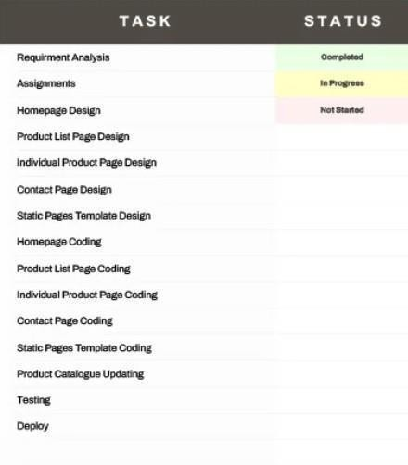
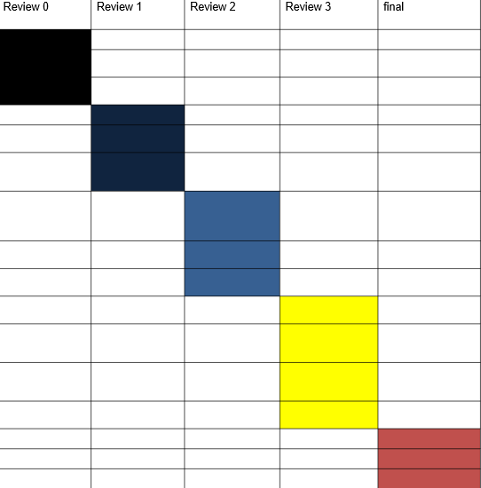
Timeline of the Project (Gantt Chart)

Slide 14
References (IEEE Paper format)
Chatbot Technologies and Applications in Various Industries:
Hussain, M. I., & Kour, H. (2020). "A comprehensive review of chatbot technologies: Applications, challenges, and future directions." IEEE Access, 8, 75221-75239. https://doi.org/10.1109/ACCESS.2020.2989620
This paper provides an overview of chatbot technologies, their applications in various industries, and outlines the challenges involved in deploying them.
Artificial Intelligence and Natural Language Processing (NLP) in Chatbots:
Alonso, A., & Garcia-Serrano, A. (2020). "Natural language processing techniques for chatbot systems: A survey." IEEE Access, 8, 120818-120832. https://doi.org/10.1109/ACCESS.2020.3006545
This survey discusses the various NLP techniques used in building effective chatbot systems, useful for integrating complex regulatory and legal information.
Legal AI Chatbots in the Legal Industry:
Binns, R., & Turner, A. (2019). "Leveraging AI and Chatbots in the Legal Industry: A Conceptual Model." IEEE International Conference on Artificial Intelligence and Law (ICAIL), 103-110. https://doi.org/10.1145/3314116.3314126
This paper explores the integration of AI and chatbots within the legal industry, offering insights that could be adapted to the mining industry's regulatory landscape.

Slide 15
References (IEEE Paper format)
AI-Driven Knowledge Management Systems (KMS) in Industry:
Jain, R., & Sharma, A. (2021). "Knowledge management systems in the mining industry: Leveraging artificial intelligence for decision-making." IEEE Transactions on Engineering Management, 68(2), 493-506. https://doi.org/10.1109/TEM.2021.3057113
This article discusses the application of AI in knowledge management systems, which is relevant to building an AI-driven chatbot for managing mining regulations.
Automation and Chatbots in Customer Service and Regulatory Information Systems:
Saxena, S., & Gaur, M. (2021). "Intelligent automation in customer service systems using AI-based chatbots." IEEE Transactions on Consumer Electronics, 67(1), 18-25. https://doi.org/10.1109/TCE.2020.2992229
Focuses on how AI-based automation, such as chatbots, can improve customer service by delivering fast and accurate information, particularly in complex sectors like mining.
NLP for Legal and Regulatory Texts:
Tariq, M. U., & Sattar, Z. (2020). "Legal document classification and information retrieval using natural language processing techniques." IEEE Access, 8, 103708-103717. https://doi.org/10.1109/ACCESS.2020.2996452
Explores how NLP techniques can be applied to legal and regulatory documents, which would be directly applicable to extracting and structuring information from mining regulations for chatbot systems.

Slide 16


